Slide 1

FaST...
Car Analytics
Frank DeMauro
Stephen Marshall
TJ Wilson

Slide 2
Data Sources
Craigslist Data(CSV)
Dataset of every craigslist car for sale in the US within the month of June 2020.
EPA Data(CSV)
Datasets are for all model years (1984–2021) and provide us the mpg data for every vehicle.
Gas Prices(API)
Average gas prices across the US (Regular, Mid-Grade, Premium, Diesel)

Slide 3
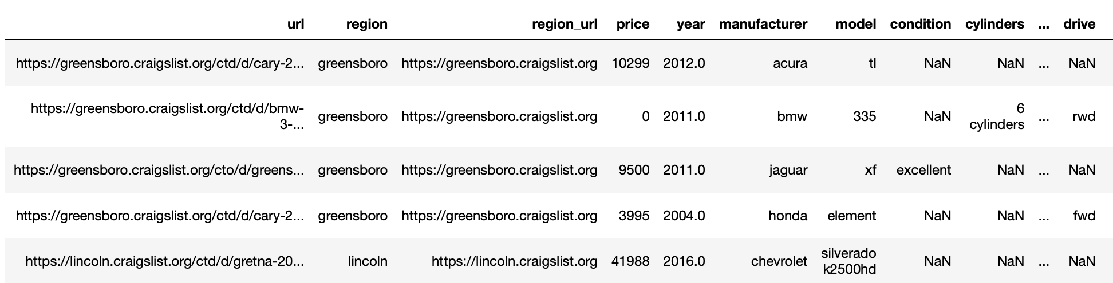
Explore Craigslist Data
This dataset was very large and came with a lot of columns in it.
The photo below is only showcasing half of the columns that we received.
Since this data is user generated, there was a lot of missing data and cleaning that was needed.

Slide 4
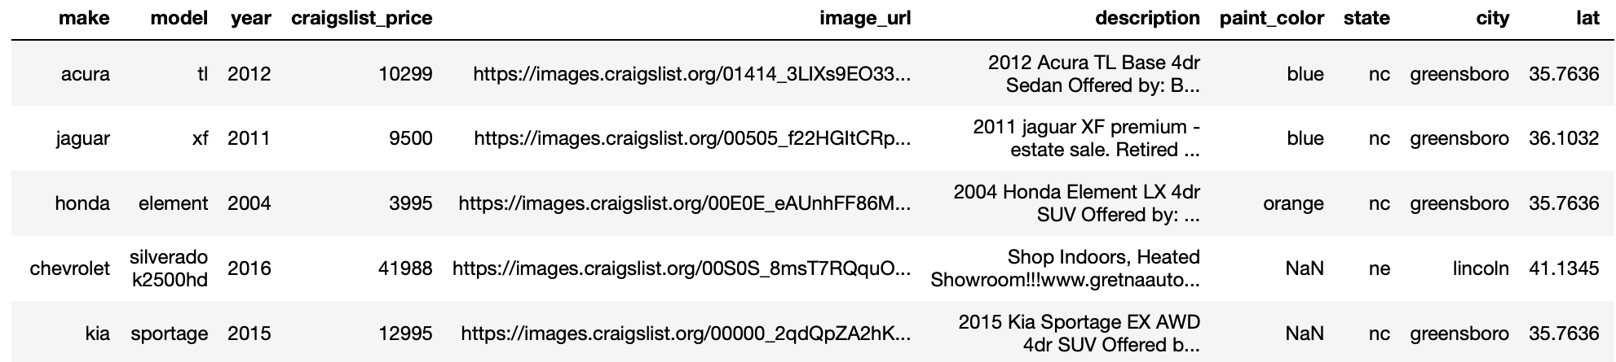
Clean Craigslist Data
Dropped unwanted and unused columns.
Removed rows where key columns of data were missing.
Started with 539,000 rows of data, but after the cleaning we ended up with roughly 483,000.
Primary Columns: Make, Model, Year, and Location.

Slide 5
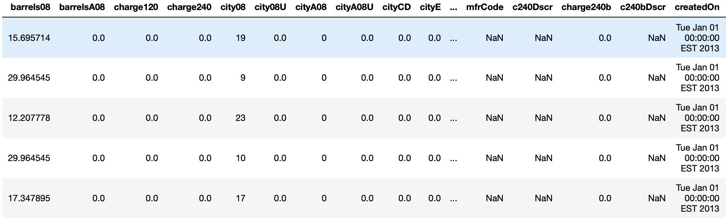
Explore MPG Data
This dataset was also very large and came with a lot of columns in it.
The photo below is only showcasing half of the columns that we received.
Although our data set is lengthy and complicated, it is high quality data since the source is the EPA.

Slide 6
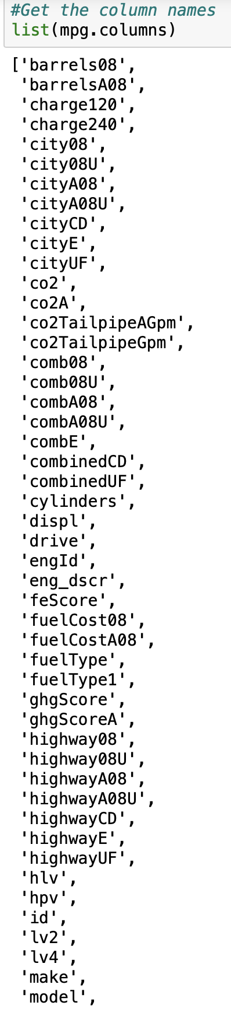
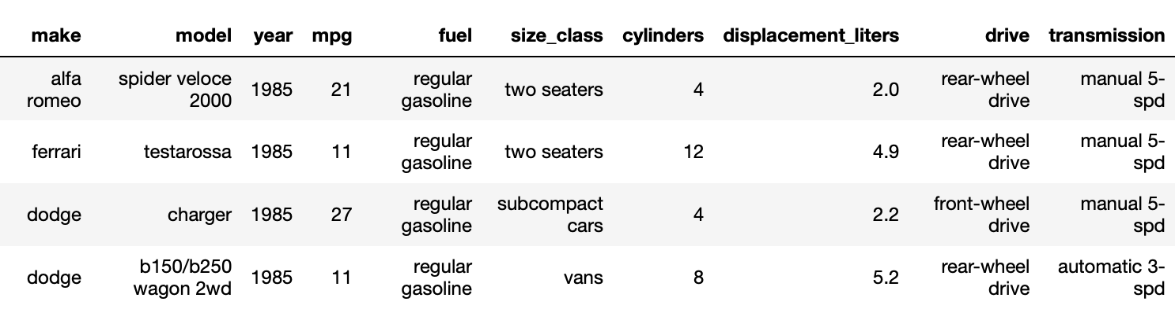
Clean MPG Data
.
Checked all the columns available in the dataset.
Grabbed the wanted columns and put it into a new dataset.
Only lost 312 rows of data after clean-up.
Primary Columns: Make, Model, Year, MPG, and location.

Slide 7

Load Data
Once our data was extracted and cleaned, we decided to load our data into an PostgreSQL database.
A relational database was chosen primarily for the backend organization that we preferred to have for this dataset.
As various new car models/info come into existence, the database will be able to capture that information and organize it in a user accessible way.
Once our data was loaded and organized into the database, we then connected it to our HTML & JS pages by creating a flask app using psycopg2 module which is a database adaptor/ORM between SQL & Python.

Slide 8
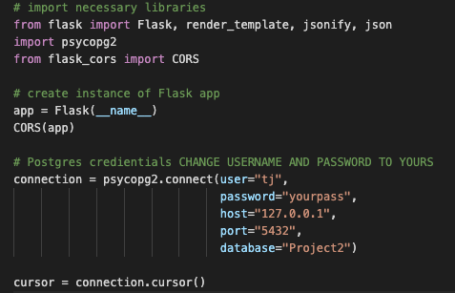
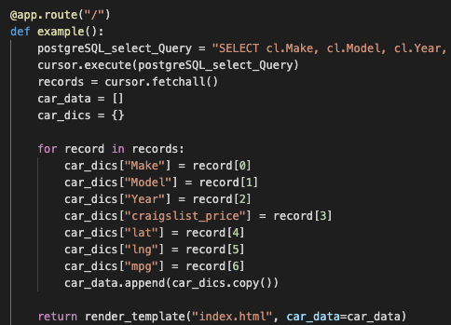
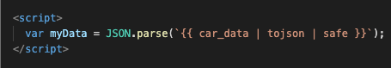
Flask App
The key aspect of this merge between our SQL database and our Python Flask app was the psycopg2 module.
It has a .connect( ) functions that allows you to make a connection your local SQL database by giving it your local configuration.
In our main route, we used cursor.execute( ) to make a SQL query to our database.
Our SQL query is a join statement that pulls from multiple tables within our database and then we put the returned data into an organized dictionary labeled as car_data
In our index.html file we add a <script> tag at the bottom to take the car_data from the flask app and then store it in global variable that can be accessed by all files as myData.

Slide 9
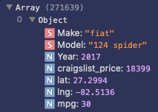
Data Manipulation in JS
The photo below showcases one index within our 271k+ long array of data.
Each index in this car_data array is an object that can be called through by its keys in our JavaScript file.
Below is an example of how we can manipulate our data based off its key values.
In the below example, we are filtering our myData results based off the selected Make & Model.

Slide 10
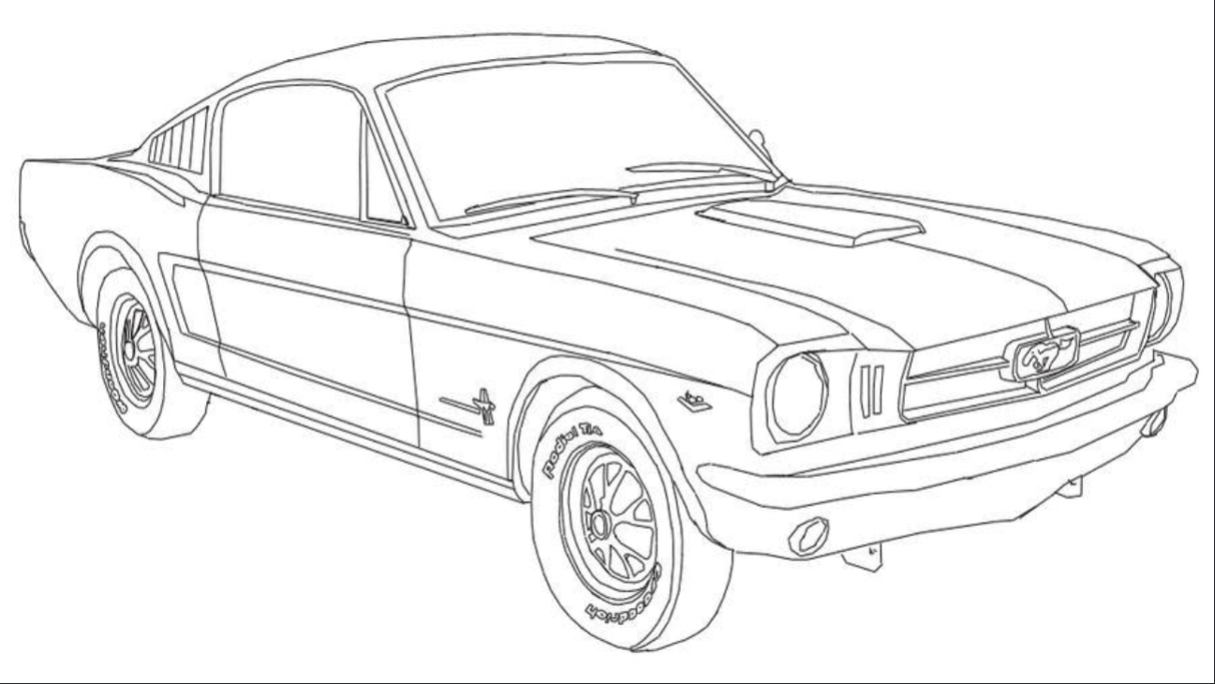
FaST... Demo

Slide 11
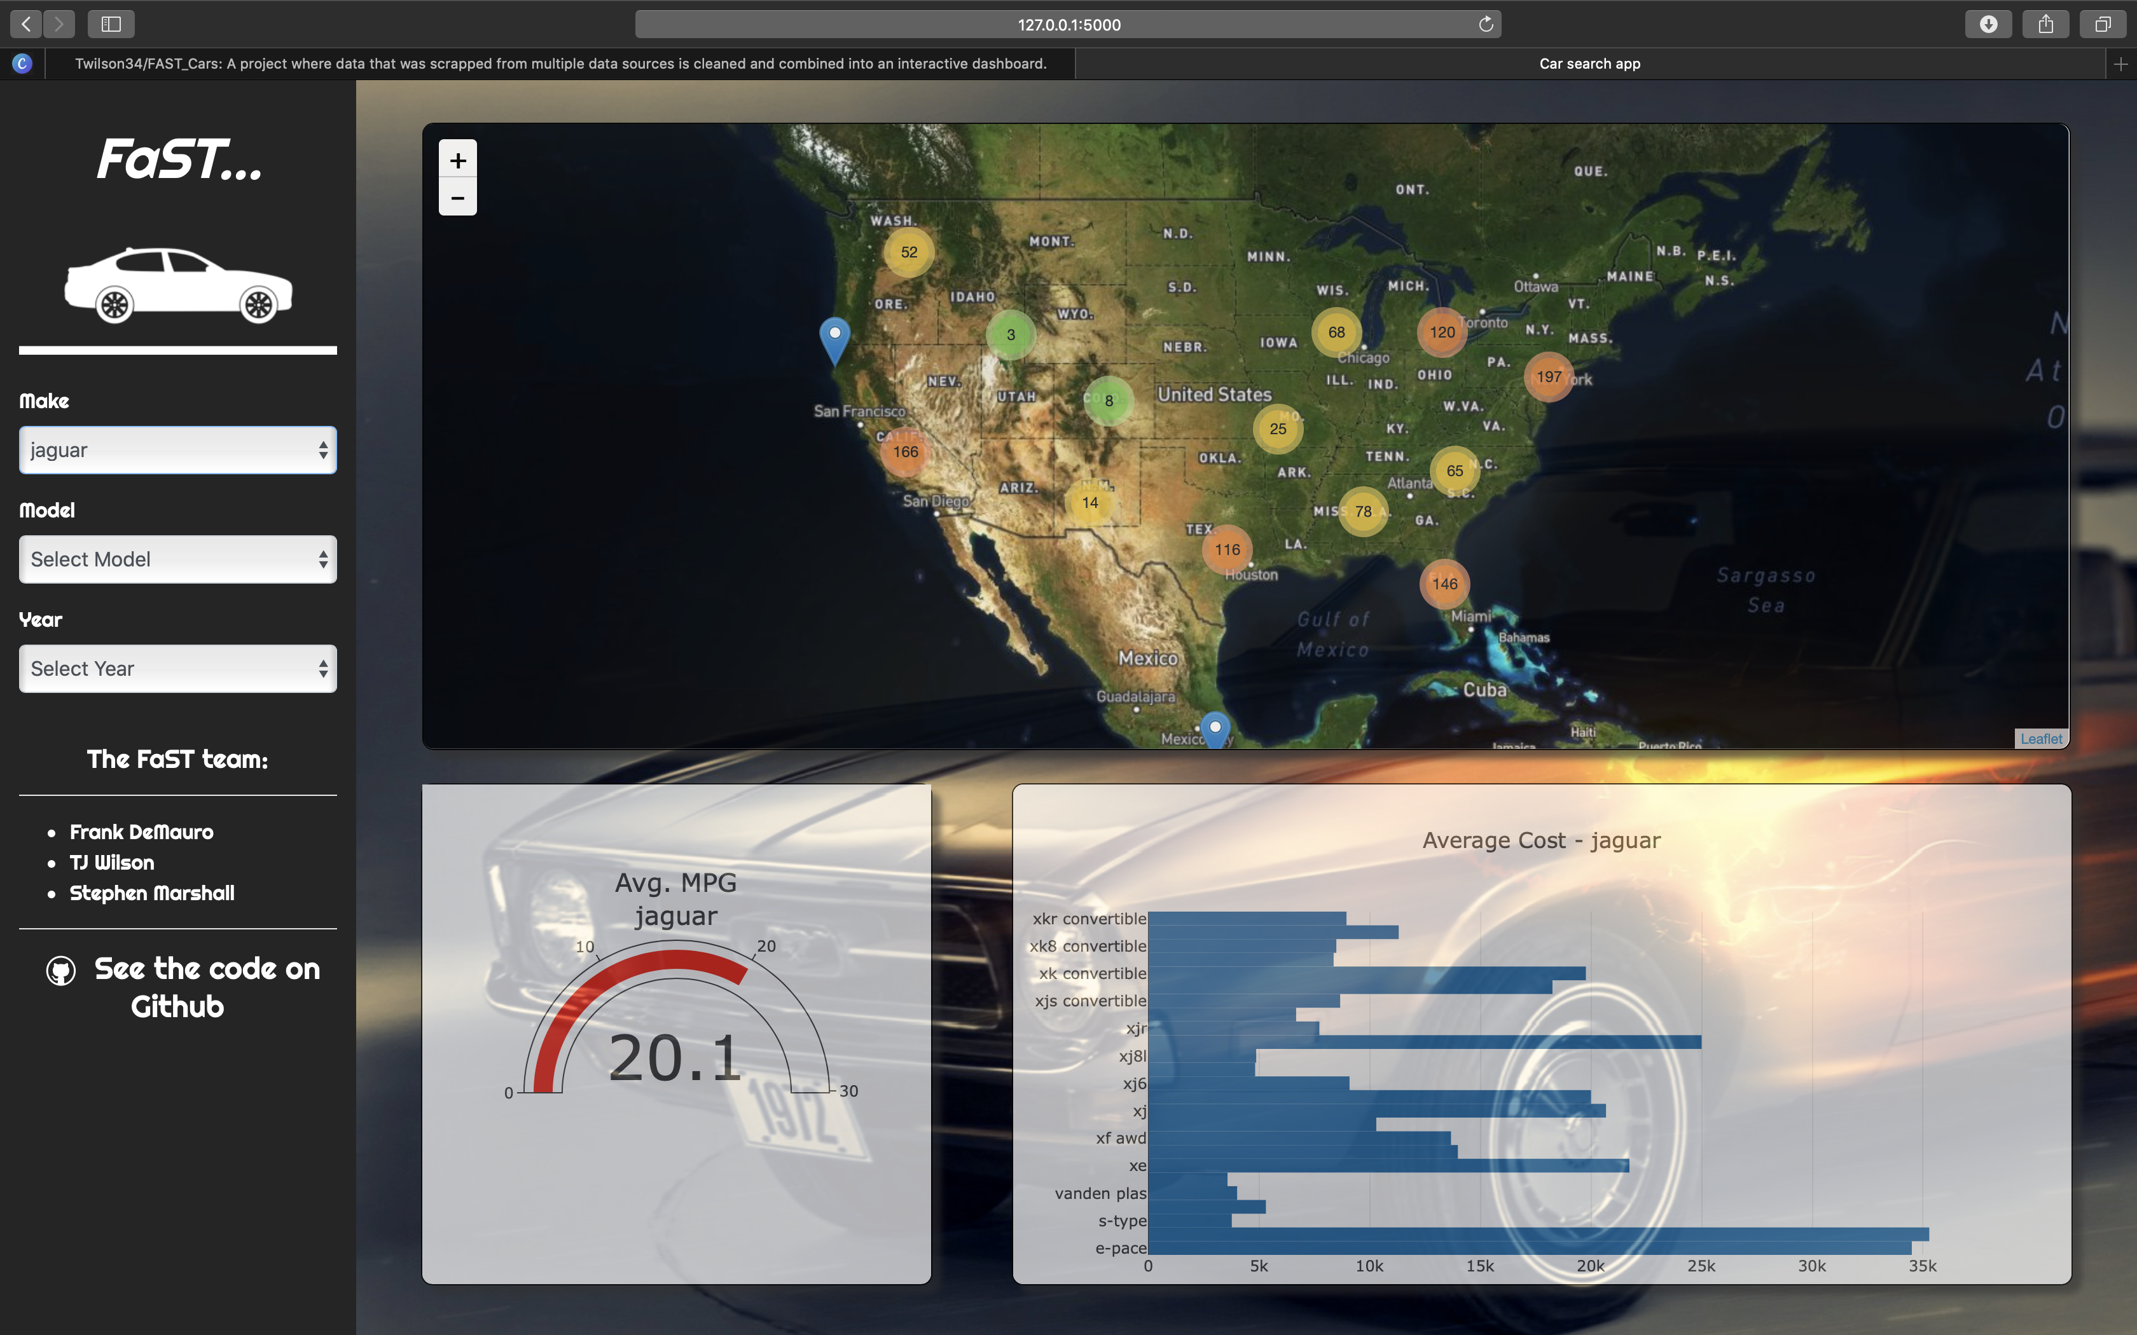
Interactive
Filters
Interactive
Interactive
As the filter elements change, the visualizations will respond.

